Slide 1
School of Geography and Geology
McMaster University
Advanced Topics in Spatial Statistics
Session 15
Area Data I

Slide 2
This session
Definitions
Visualization and exploration of area data
  First order properties
  Second order properties
Modeling area data
  Main methods
Example: Exploratory data analysis

Slide 3
Definitions
Examples of data in the social sciences
  Urban population density
    What is the distribution of population in a city?
    Links to locational theory
  Residential insurance coverage
    Do insurance companies redline neighborhoods?

Slide 4
Definitions
Examples of data in the social sciences
  Urban crime
    Does criminal behavior follow spatial patterns?
    Are there spillover effects?
  Geographic distribution of minorities
    Is there spatial segregation of minorities?

Slide 5
Definitions
Examples of data in the social sciences
  Voter turnout
    What explains voter turnout in elections?

Slide 6
Definitions
Area data in the environmental sciences
  Agricultural experiments in regularly tilled fields
  Species habitat
  Intersection between social and environmental sciences
    NOx spillovers in Europe

Slide 7
Definitions: Regular Lattice

Slide 8
Definitions: Regular Lattice

Slide 9
Definitions: Regular Lattice

Slide 10
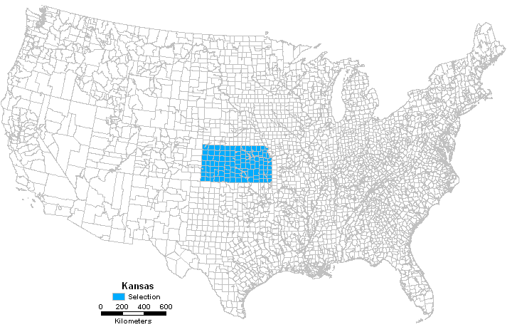
Definitions: Irregular Lattice
Counties in the United States

Slide 11
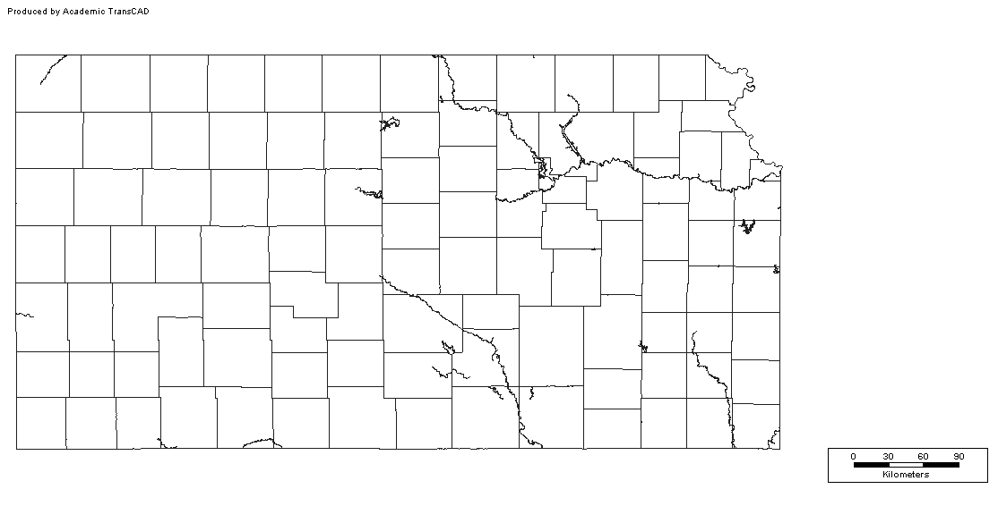
Definitions: Irregular Lattice
Counties in Kansas State

Slide 12
Definitions
Zones (Areas)
Attributes
Example: Urban population density
  What attributes?
Example: Agricultural trials
  What attributes?

Slide 13
Definitions
Other data in the social sciences
  Land prices?
  House prices?
Other data in the environmental sciences
  Bird nesting patterns?
Point data can be converted to area data

Slide 14
Definitions
Network data
  The units of analysis are nodes in a network
  For example, cities in a transportation network
  Network connectivity gives the proximity matrix

Slide 15
Definitions
Examples of data in the social sciences
  Voter turnout
    What explains voter turnout in elections?

Slide 16
Definitions
Research questions (spatially continuous data)
  Structural analysis
  Interpolation/prediction
  Quantifying uncertainty
Research questions (area data)
  Structural analysis
  Explanation
  Quantifying uncertainty

Slide 17
Research Questions:
Why not interpolation?

Slide 18
Research Questions:
Why not interpolation?

Slide 19








Research Questions:
Why not interpolation?
(unobserved)

Slide 20
Analysis of Area Data
Main objective is to explain and possibly to forecast
Analysis follows the usual sequence:
  Visualization and exploration
  Modeling
  First order and second order effects

Slide 21
Visualization of Area Data
Visualization
  Proportional symbol maps
  Choropleth maps

Slide 22
Exploration of Area Data
Exploration
  First order properties
    Spatial Moving Averages
    Median Polish
    Kernel Estimation
  Second order properties
    Spatial autocorrelation

Slide 23
Exploration of Area Data
Spatial proximity matrices
  Define the pattern of contacts, connections or relationships between areas or points in a study area

Slide 24
Modeling Spatially Continuous Data
Non-spatial regression models
  Tests for spatial autocorrelation
Spatial regression models
  Pure autoregressive
  Mixed autoregressive
  Simultaneous autoregressive
  Conditional autoregressive

Slide 25
Example
Presidential election voter turnout (Kansas, 1980)
  Total number of votes cast per county in the 1980 presidential election for both candidates (VOTES)
  Voting age population (POP)
  Population in each county with 12th grade or higher education (EDU)
  Number of owner occupied houses (HOUSE)
  Aggregate income in the county (INCOME)

Slide 26
Example
Presidential election voter turnout (Kansas, 1980)
  Potential issues
    What are the factors that influence voter turnout?
    How can voter turnout be increased?
    Certain population segments are more commonly identified with a given political party

Slide 27
Example: Voter turnout
Zoning system: 105 counties

Slide 28
Example: Voter turnout
Zoning system: 105 counties
  Proximity matrix defined in terms of first order contiguities

Slide 29
Exploratory Data Analysis
Univariate analysis
  Histogram
  Maps
  Moving averages
  Autocorrelation

Slide 30
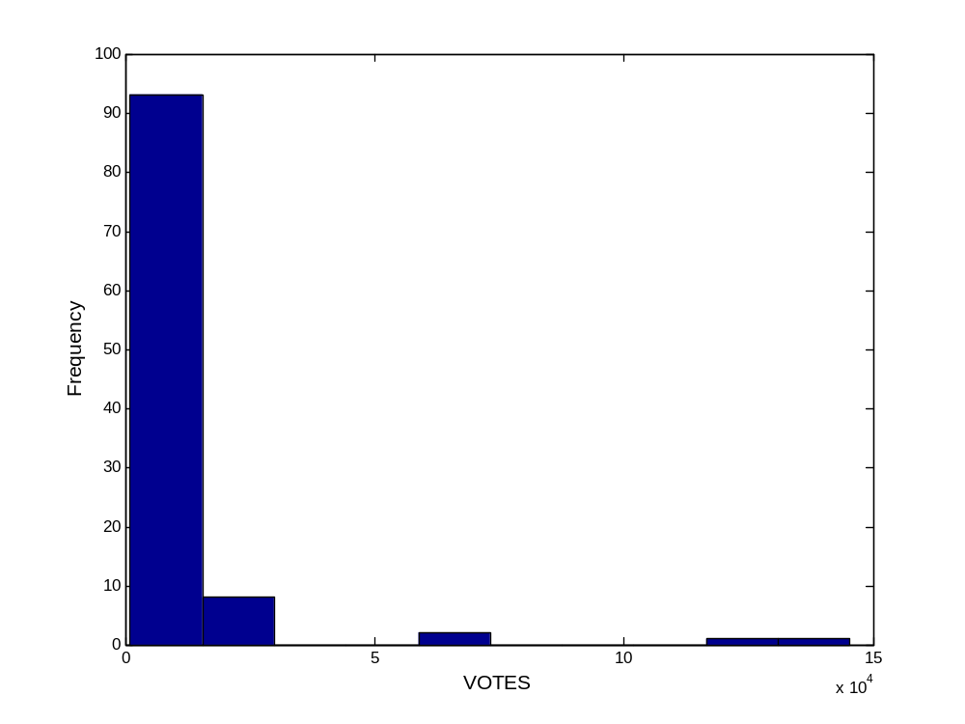
Exploratory Data Analysis
Histogram: Votes

Slide 31
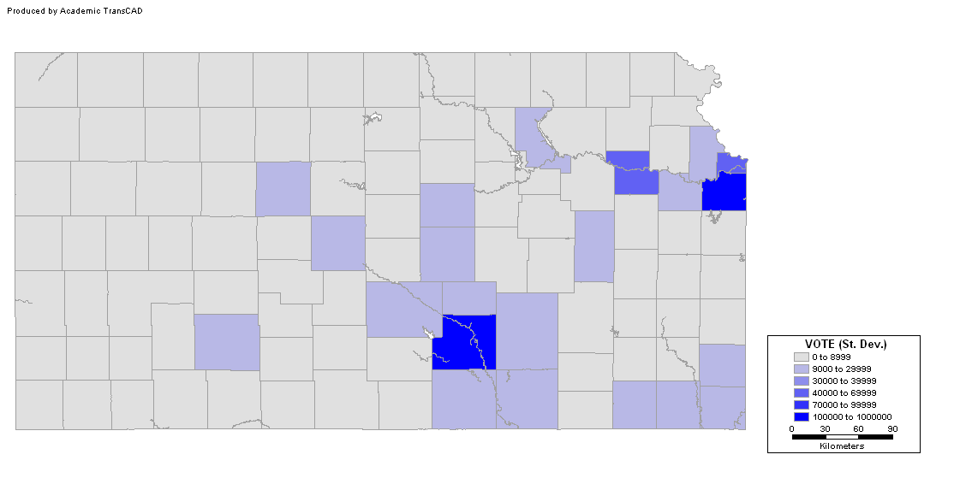
Exploratory Data Analysis
Choropleth map: Votes (Std. Dev.)
Notes:
What is the advantage of using standard deviations?

Slide 32
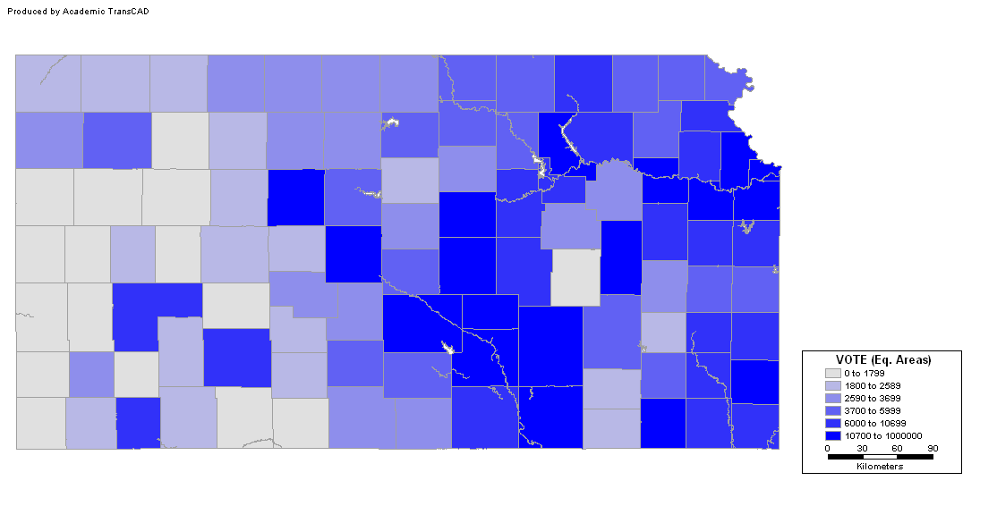
Exploratory Data Analysis
Choropleth map: Votes (Eq. Areas)

Slide 33
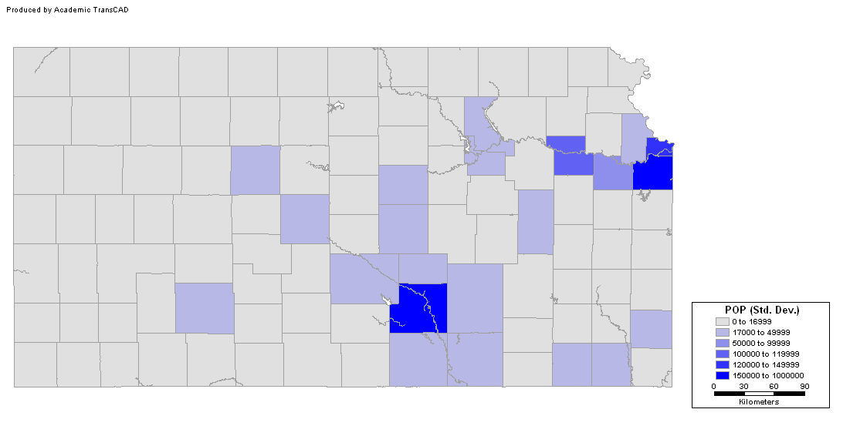
Exploratory Data Analysis
POP (Std. Dev.)
Notes:
What is the advantage of using standard deviations?

Slide 34
Exploratory Data Analysis
Votes
Notes:
What is the advantage of using standard deviations?

Slide 35
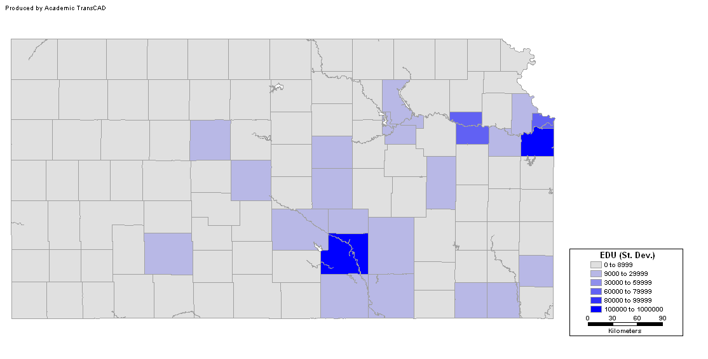
Exploratory Data Analysis
EDU (Std. Dev.)
Notes:
What is the advantage of using standard deviations?

Slide 36
Exploratory SPATIAL Data Analysis
Spatially moving averages (first order properties)
Spatial autocorrelation (second order properties)

Slide 37
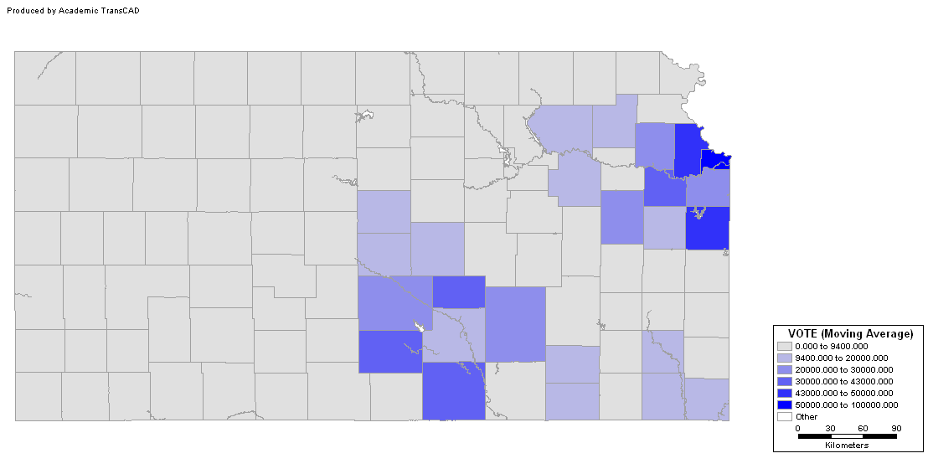
Exploratory Spatial Data Analysis
Votes (Moving Average)

Slide 38
Exploratory Spatial Data Analysis
Spatial autocorrelation
  Standardized Moran’s I (normal distribution)
  Null hypothesis: no autocorrelation
  All tests are significant (p<0.05)
Variable | Z(I)
VOTE | 3.47
POP | 3.78
EDU | 3.36
HOUSE | 3.75
INCOME | 3.14

Slide 39
Conclusion
Voting patterns follow a spatial pattern
The spatial pattern is very clear, and probably relates to urban concentrations
Voting is probably correlated with population, education and other variables

Slide 40
Next…
Area data II
  Non-spatial regression
  Error autocorrelation and other guidelines for model evaluation

